Slide 1
Object Oriented Development with Java (CT038-3-2-OODJ and Version VC1)
Introduction and Overview

Slide 2
Lecturer information
Lecturer Name:Minnu Helen Joseph
Email: minnu.helen@apu.edu.my
Telephone Extension:

Slide 3
Pre-requisites for this module
Fundamentals of Software Development or equivalent

Slide 4
Aims of this module
This is a programming module designed to introduce you to programming in the Java language and software development using Object Oriented techniques

Slide 5
Course Learning outcomes, CLOs
At the end of this course, YOU should be able to:
Explain the techniques of Object-Oriented Design
Design and implement a software application that exploits the strength of object oriented paradigm
Demonstrate the use of object oriented concepts and their functionalities in the existing systems

Slide 6
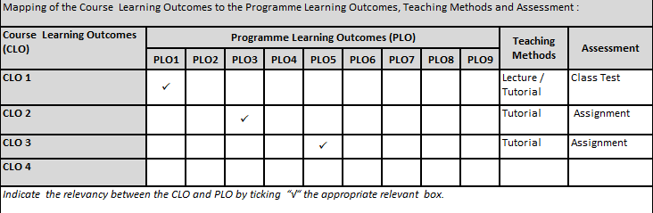
Mapping of CLOs with MOEs Domain
PLO1 – Knowledge
PLO3- Problem Solving and Scientific Skills
PLO5 – Social Skills, Teamwork and Responsibilities

Slide 7
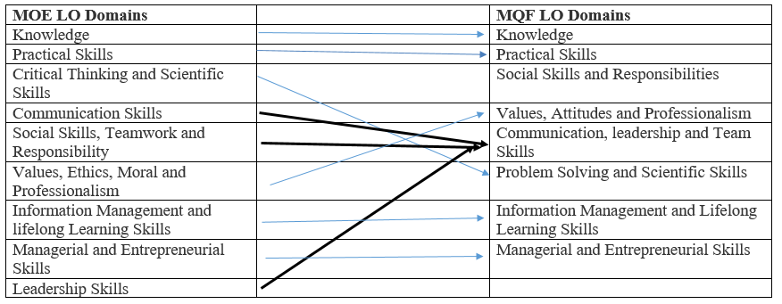
MQF and MOE Domains

Slide 8
Teaching Strategies
Lecture
Tutorial

Slide 9
Assessment Methods
Class Test (20%) : CLO1
Group Assignment (80%)
Design and implement an application : CLO2
Presentation: CLO3
**refer to SAIS for details

Slide 10
Student Learning Time (SLT)
Course Credit Value: 3
Total Learning Hours:
Lecture : 3 hours per semester
Tutorial : 39 hours per semester
Independent Learning Time: 56 hours

Slide 11
Methods of Delivery
Hence,
We are now moving from the traditional topic based teaching to outcome-based education

Slide 12
Outcomes Based Education (OBE)
OBE is education based on producing particular educational outcomes that:
Focus on what students can actually do after they are taught
Expect all learners / students to successfully achieve particular (sometimes minimum) level of knowledge and abilities.

Slide 13
So…What is OBE?
It’s
NOT
What we want to teach,
It’s
What You should learn

Slide 14
Course Content Outline
CLO1 : Class Test (20%)
Lecture
Overview of Java Programming
Basic Java Syntax
Data types and operators
Decision Making

Slide 15
Course Content Outline
CLO2 & CLO3 : Group Assignment (80%)
Tutorial / Case Study
Java OO concepts
Inheritance and abstraction
Polymorphism and Encapsulation
Packages
Exceptions
Java GUI
Input / Output Files
JDBC
Java Collection Framework
UML diagrams

Slide 16
What is expected of you
What is expected of you
You should abide to all the rules & regulation of APU
Proper attire
No speaking of dialects
Attendance is compulsory and valid medical certificates or letters from parents /guardians must support any absence from class.
Three lateness will be equal to one absence
All pagers and handphones should be turned off during lectures.

Slide 17
What support is available for you
Consultation hours
Resources
Reference material
Essential Reading
-Paul,Deitel and Harvey, Deitel. (2018) Java:How to Program,Early Objects.11th Ed.Harlow,United Kingdom:Pearson Education.ISBN13: 978-0134743356 -Sedgewick, R. and Wayne, K.( 2017) Introduction to programming in Java: an interdisciplinary approach.2nd Ed.Berkeley,United States:Pearson Education(US).ISBN13:978-0672337840 --Daniel,Y.(2013) Intro to Java Programming, Comprehensive Version.10th Ed.New Jersey,United States: Prentice Hall.ISBN13: 978-0133813463
Internet resources
Software : NetBeans IDE 8.2

Slide 18
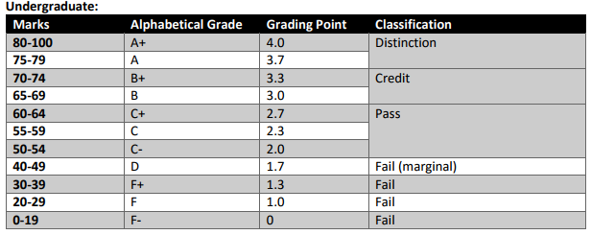
Achievement requirements

Slide 19
Question and answer session
Q & A

Slide 20
What we will cover next
Introduction to Java Fundamentals, Data types and Decision Making

